Slide 1

Hotel Rating Classification
Mentor :
Group 5
Team Members:
Utkarsh Sharma
Aswin. P
M. Sakthi
Bhagyashree Ambade
Shruthi Thandan
Vaishnavi Puram
Sagar. C

Slide 2
Business Problem:
To classify travelers positive and negative experience in online platform for staying specific hotel
Objective:
The dataset which consists of 20,000 reviews and ratings for different hotels and our goal is to examine how travellers are communicating their positive and negative experiences in online platforms for staying in a specific hotel and major objective is what are the attributes that travellers are considering while selecting a hotel. With this manager can understand which elements of their hotel influence more in forming a positive review or improves hotel brand image.
Using the above information & the dataset and applying the different machine learning techniques to classify weather travelers reviews are positive, negative or neutral

Slide 3
Project Workflow
Data Collection
Data Preparation
Exploratory Data Analysis
Modeling
Model Evaluation
Model Deployment
Business Understanding

Slide 4
Data Set Details:
Shape of the dataset is 20491 Rows ,2 Columns.
The two features are “Reviews” and “Ratings”.
Reviews Feature contain categorical values and it is a “object” Datatype.
Ratings Feature contain numerical values and it is a “float64” Datatype.
There are No null or missing values.
The python libraries and packages we will use in this project are namely:
NumPy
Pandas
Seaborn
Matplotlib

Slide 5
Exploratory Data Analysis (EDA) and
Feature Engineering

Slide 6
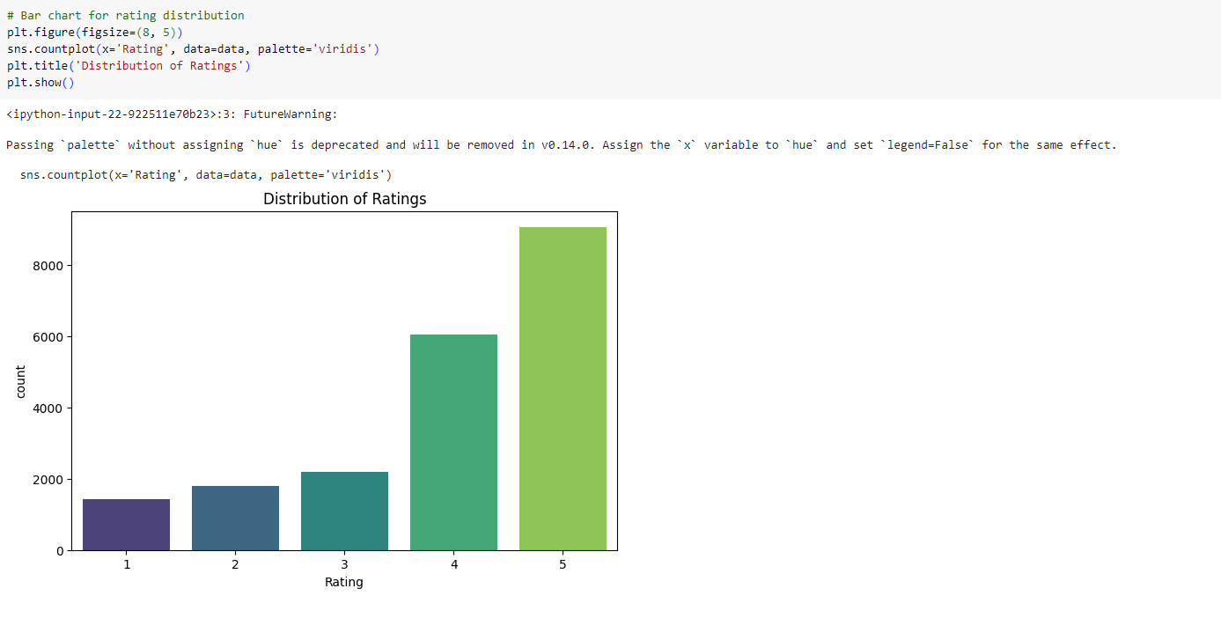
EDA
Bar Chart For Rating Distribution

Slide 7
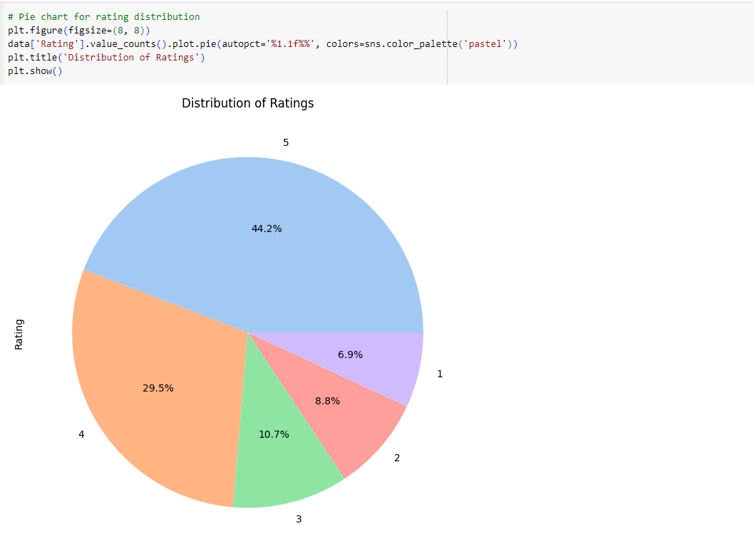
Pie Chart for Rating Distribution

Slide 8
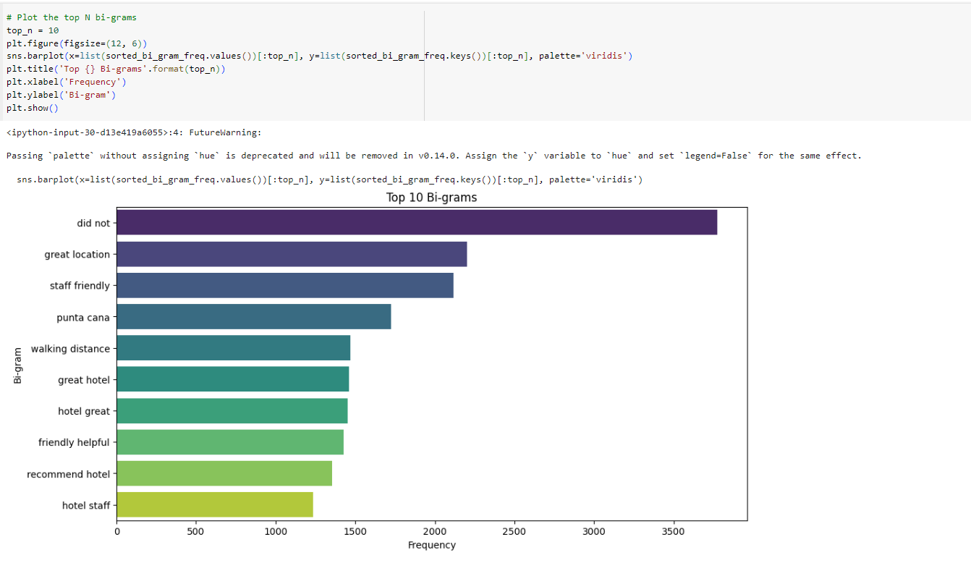
Bi-Gram

Slide 9
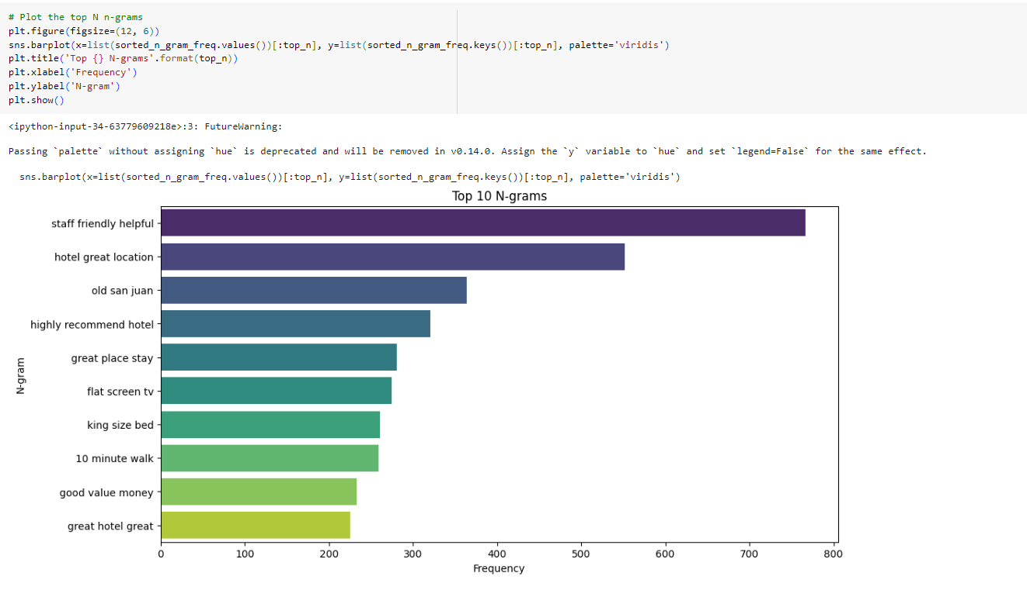
N-Gram

Slide 10
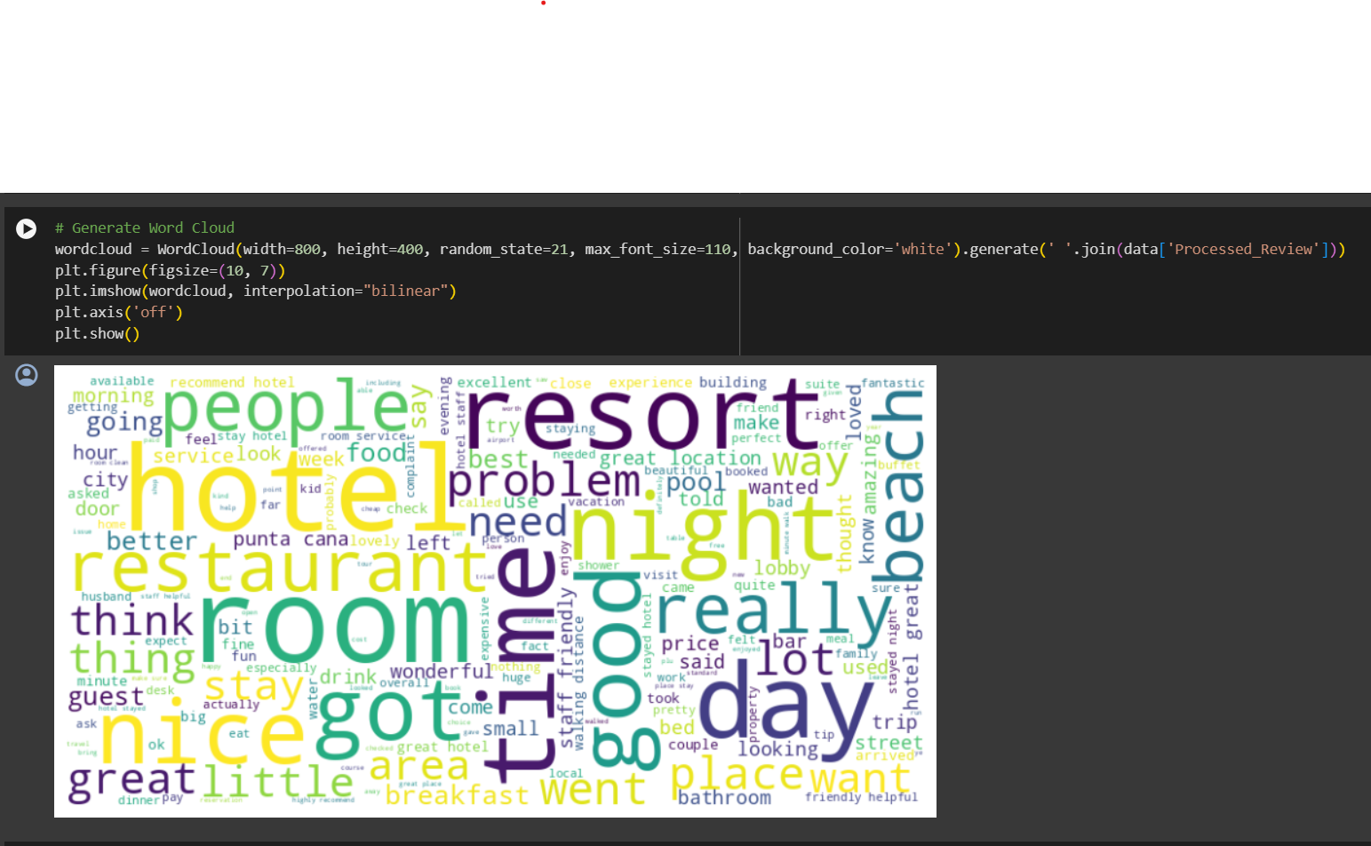
Word Cloud

Slide 11
Sentiment Analysis

Slide 12
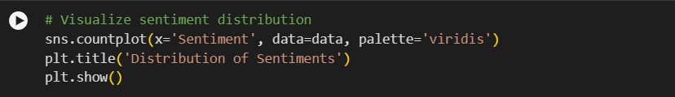
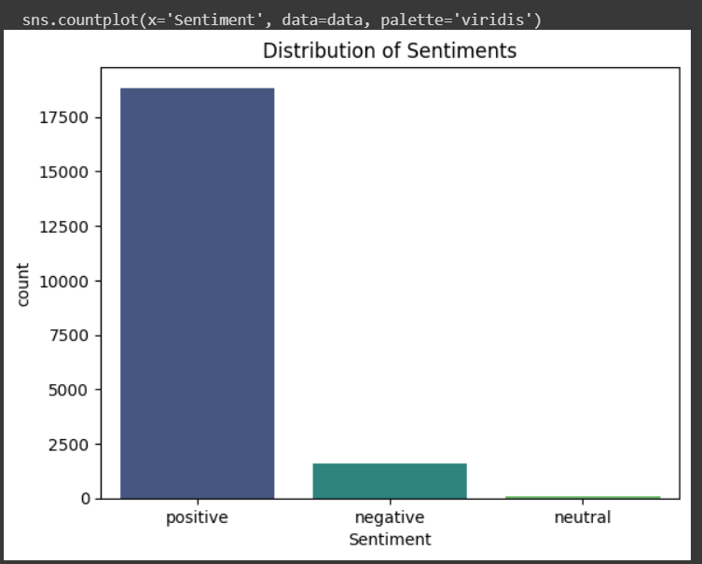
SENTIMENT ANALYSIS USING COUNT-PLOT

Slide 13
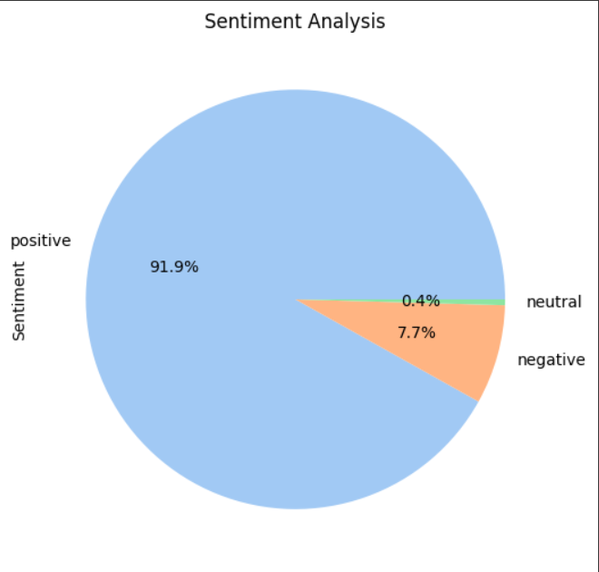
Sentiment Analysis using Pie Chart

Slide 14
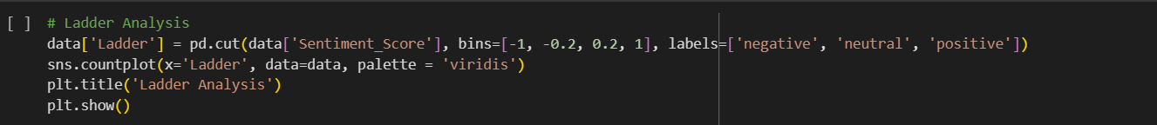
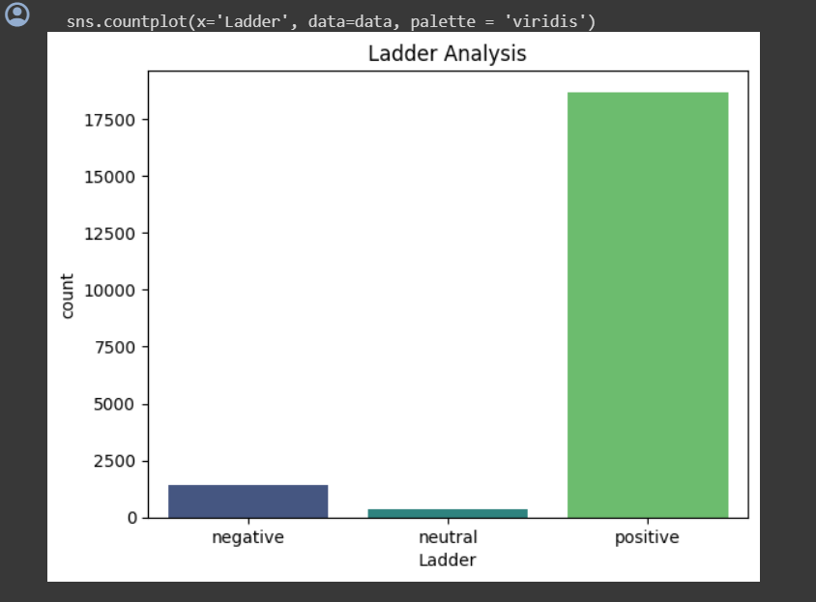
LADDER ANALYSIS

Slide 15
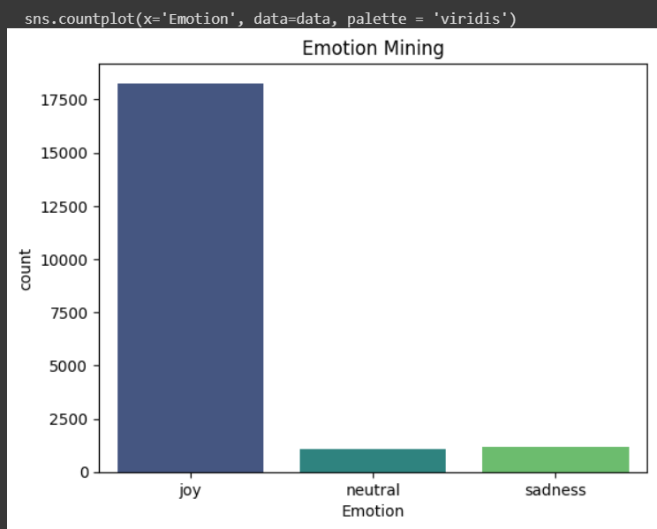
EMOTION MINING

Slide 16
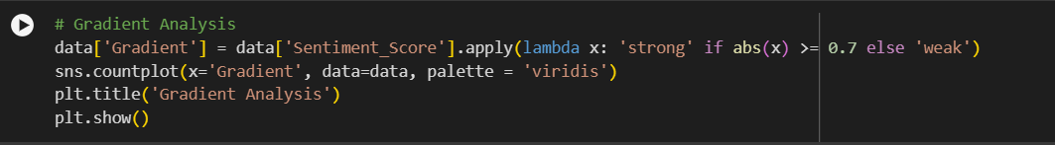
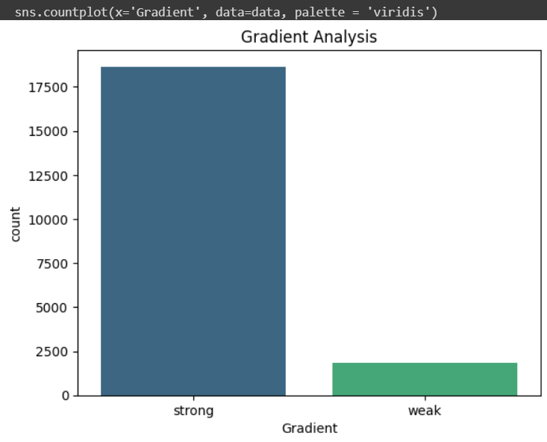
GRADIENT ANALYSIS

Slide 17
Model Building

Slide 18

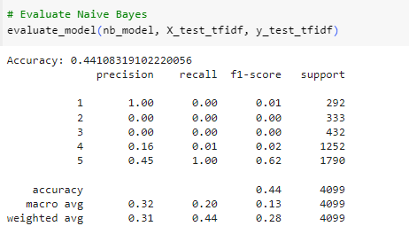
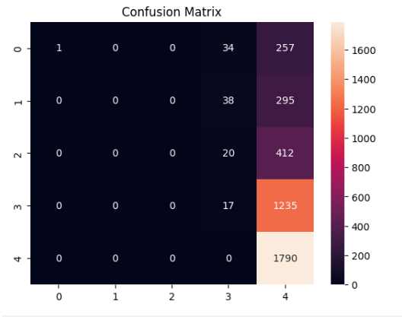
Model Building using Multinominal Naïve Bayes
This model is chosen for text classification tasks, especially when working with word counts, as it assumes that features are generated from a multinomial distribution.

Slide 19
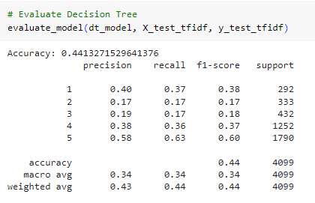
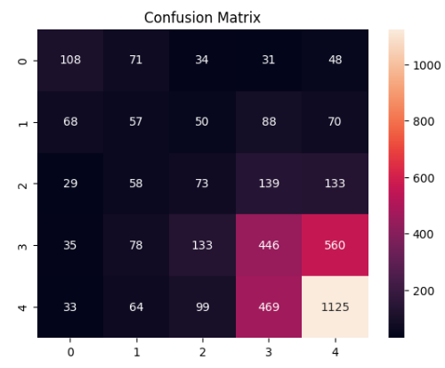
Model Building using Decision Tree
Decision Trees are a type of supervised learning algorithm that can be used for classification tasks. They split the dataset into subsets based on the most significant attribute at each node.

Slide 20
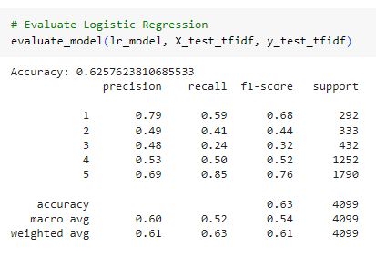
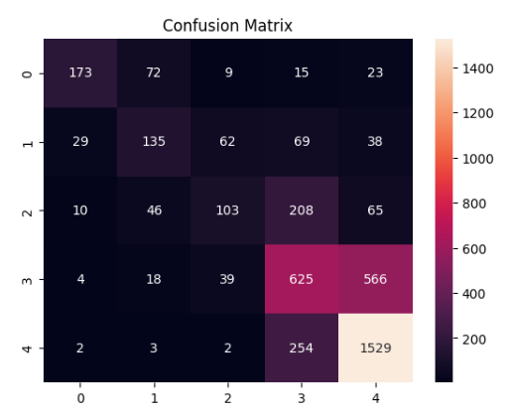
Model Building using Logistic Regression
Logistic regression is a classification algorithm. It models the probability of an instance belonging to a particular category.

Slide 21
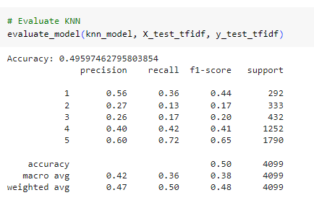
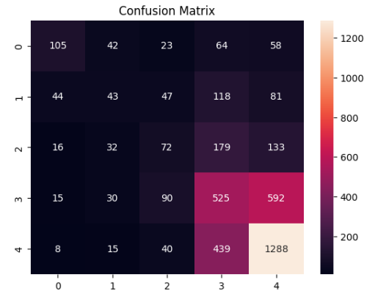
Model Building using KNN
KNN is a non-parametric, lazy learning algorithm that classifies a data point based on how its neighbors are classified.

Slide 22
Deployment

Slide 23
Deployment
Deployment is essential for making software applications accessible to users, testing them in real-world environments, gathering feedback, optimizing performance and scalability, ensuring security and compliance.
We are Using Streamlit for Deployment.

Slide 24
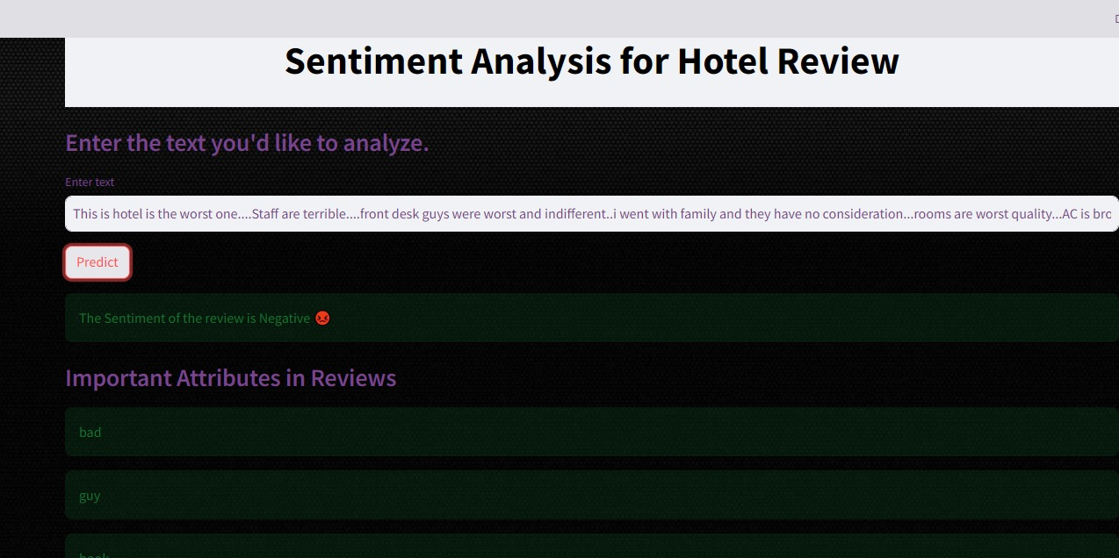

Slide 25
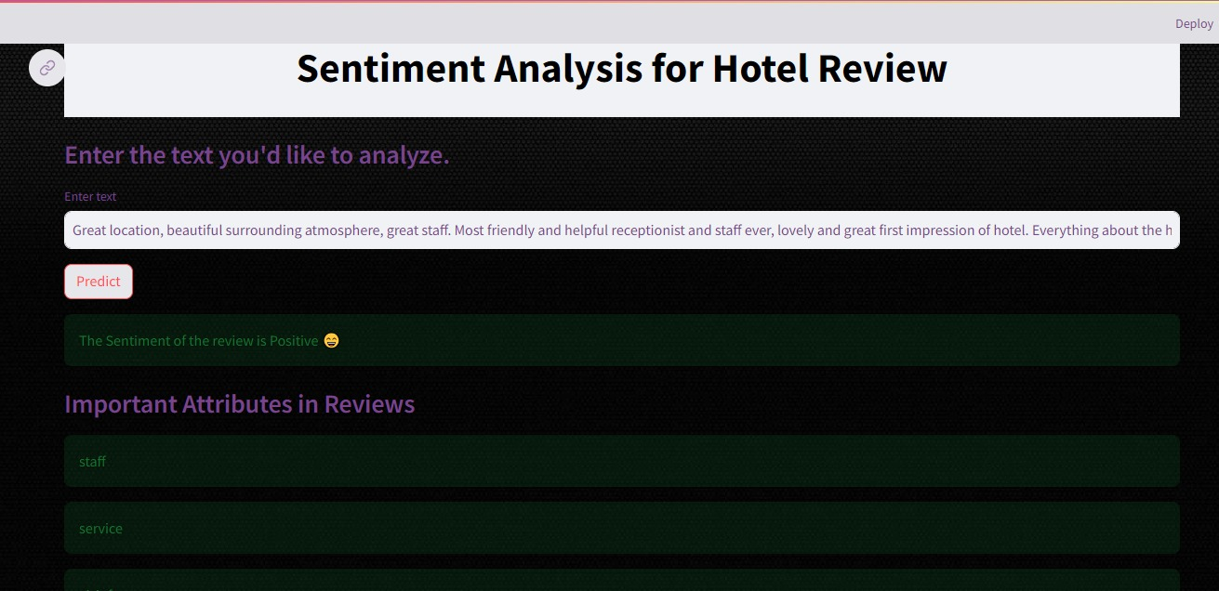

Slide 26
Challenges and Difficulties
Building a machine learning model for hotel review analysis involves several challenges and difficulties. It includes:
Data Preprocessing Challenges
Sentiment Analysis Challenges
Model Selection and Evaluation
Hyperparameter Tuning

Slide 27
Data Preprocessing Challenges:
Data Cleaning: Hotel review data contain spelling errors, grammatical mistakes, and inconsistent formatting. Cleaning and standardizing the text data is crucial but can be time-consuming.
Stopword Removal: Removing stopwords (commonly occurring words like 'and', 'the', 'is') is essential for text analysis. However, deciding which words to remove and which to retain can be subjective.
Tokenization: Tokenizing the text involves splitting it into individual words or tokens. However, tokenization may not always capture the nuances of the text, especially in languages with complex grammar.
Sentiment Analysis Challenges:
Subjectivity: Sentiment analysis is inherently subjective, as individuals interpret the same review differently. Identifying and accounting for subjective language and opinions is challenging.
Sarcasm and Irony: Hotel reviews often contain sarcasm, irony, and figurative language. Detecting such nuances requires sophisticated natural language processing (NLP) techniques.
Rating Scale: Mapping textual sentiment to numerical rating scales can be ambiguous. For example, a review rated '3 stars' may contain positive sentiment, negative sentiment, or both.

Slide 28
3.Model Selection and Evaluation:
Model Complexity: Selecting an appropriate machine learning model involves balancing complexity and performance. Simple models like Naive Bayes may underfit, while complex models like deep learning architectures may overfit.
Evaluation Metrics: Choosing the right evaluation metrics for model performance is critical. Accuracy alone may not be sufficient, especially for imbalanced datasets. Metrics like precision, recall, and F1-score provide a more comprehensive understanding of model performance.
4.Hyperparameter Tuning:
Grid Search: Hyperparameter tuning using techniques like GridSearchCV requires significant computational resources and may become impractical for large hyperparameter spaces.
Overfitting: Tuning hyperparameters can lead to overfitting on the validation set, reducing the model's ability to generalize to unseen data.

Slide 29
Thank-you

